Slide 1
Routing

Slide 2
Routing
One of the main functions of network layer.
From the source machine to the destination machine
Routing versus forwarding?

Slide 3
Routing Algorithm
Computes routing tables.
Properties:
Correctness.
Robustness.
Stability.
Optimality.
Try to optimize a certain metric.

Slide 4
Optimality Principle
General statement about optimal routes
topology
routing algorithm independent

Slide 5
Types of Routing Algorithms
Non-adaptive
Adaptive.

Slide 6
Adaptive and Non-adaptive Routing
Non-adaptive routing:
Fixed routing, static routing.
Do not take current state of the network (e.g., load, topology).
Routes are computed in advance, off-line, and downloaded to routers when booted.
Adaptive routing:
Routes change dynamically as function of current state of network.
Algorithms vary on how they get routing information, metrics used, and when they change routes.

Slide 7
Static Algorithms
(Non-Adaptive)
Shortest-path routing.
Flooding.

Slide 8
Shortest-Path Routing
Problem: Given a graph, where nodes represent routers and edges, links, find shortest path between a given pair of nodes.
What is shortest in shortest path?
Depends on the routing metric in use.
Example: number of hops (static), geographic distance (static), delay, bandwidth (raw versus available), combination of a subset of these.
Dijkstra’s shortest-path algorithm (1959).

Slide 9
Dijkstra’s Shortest-Path Algorithm
Initially, links are assigned costs.
As the algorithm executes, nodes are labeled with its distance to source along best known path.
Initially, no routes known, so all nodes are labeled with infinity.
Labels change as the algorithm proceeds.
Labels can be temporary or permanent.
Initially all labels are tentative.
A label becomes permanent if it represents the shortest path from the source to the node.

Slide 10
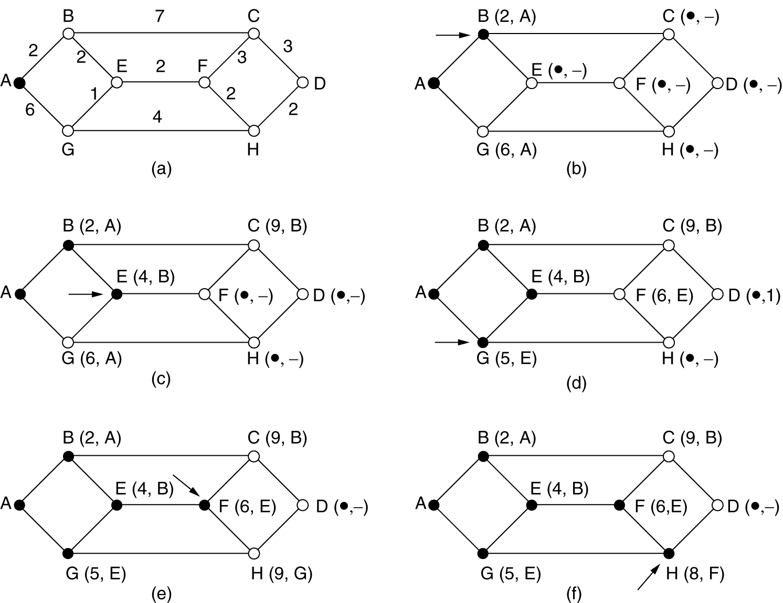
Shortest Path Routing
Label each adjacent node
with distance to A.
Find shortest-path from A to D:
Start
B is made
permanent.

Slide 11
Flooding
Every incoming packet forwarded on every outgoing link except the one it arrived on.
Problem: duplicates.
Constraining the flood:
Hop count.
Keep track of packets that have been flooded.
Robust
Shortest

Slide 12
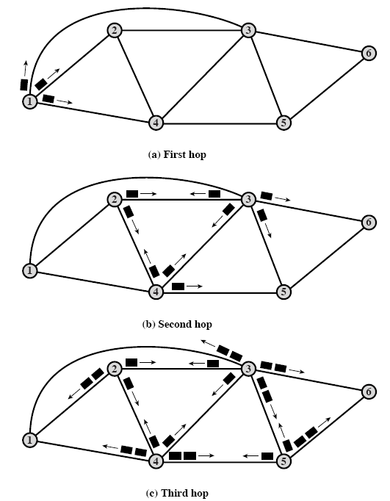
Flooding: Example

Slide 13
Dynamic Routing Algorithms
(Adaptive Routing)
Distance vector routing.

Slide 14
Distance Vector Routing
Aka, Bellman-Ford (1957
Original ARPANET routing; also used by Internet’s RIP.
Each router keeps routing table (or routing vector) with best known distance to each destination and corresponding outgoing interface.
Routing tables are updated by exchanging routing information with neighbors.

Slide 15
Distance Vector (Cont’d)
Routing table at each router:
One entry per participating router.
Each entry contains outgoing interface and distance to corresponding destination.
Metric: number of hops, delay, queue length.
Each router knows distance to its neighbors.

Slide 16
An Example
 | A | B | C | D | E | F | G
A | 0 | 1 | 1 | ∞ | 1 | 1 | ∞
B | 1 | 0 | 1 | ∞ | ∞ | ∞ | ∞
C | 1 | 1 | 0 | 1 | ∞ | ∞ | ∞
D | ∞ | ∞ | 1 | 0 | ∞ | ∞ | 1
E | 1 | ∞ | ∞ | ∞ | 0 | ∞ | ∞
F | 1 | ∞ | ∞ | ∞ | ∞ | 0 | 1
G | ∞ | ∞ | ∞ | 1 | ∞ | 1 | 0
Internal Information at each node ----->

Slide 17
Routing Tables
 | Cost | Next Hop
B | 1 | B
C | 1 | C
D | ∞ | -
E | 1 | E
F | 1 | F
G | ∞ | -
With this information, routing table at A is -->

Slide 18
Evolution of the table.
Each node sends a message to neighbors with a list of distances.
F --> A with G is at a distance 1
C --> A with D at distance 1.
 | Cost | Next Hop
B | 1 | B
C | 1 | C
D | 2 | C
E | 1 | E
F | 1 | F
G | 2 | F

Slide 19
Final Distance Matrix
 | A | B | C | D | E | F | G
A | 0 | 1 | 1 | 2 | 1 | 1 | 2
B | 1 | 0 | 1 | 2 | 2 | 2 | 3
C | 1 | 1 | 0 | 1 | 2 | 2 | 2
D | 2 | 2 | 1 | 0 | 3 | 2 | 1
E | 1 | 2 | 2 | 3 | 0 | 2 | 3
F | 1 | 2 | 2 | 2 | 2 | 0 | 1
G | 2 | 3 | 2 | 1 | 3 | 1 | 0

Slide 20
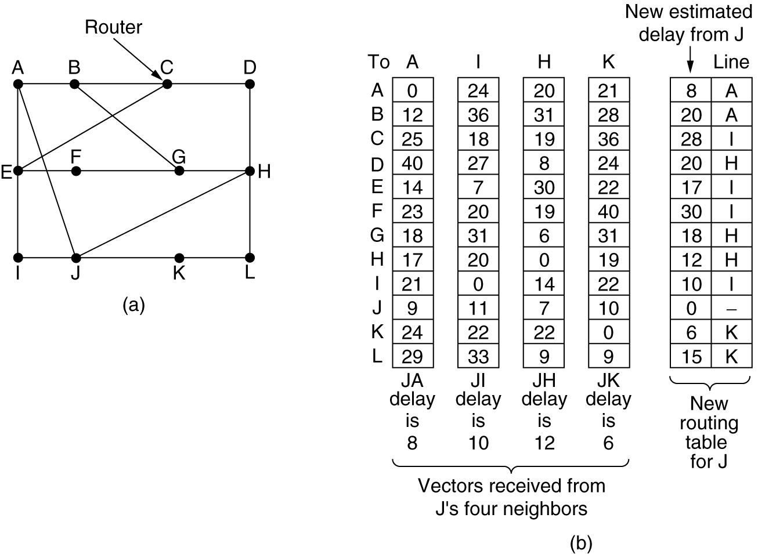
Distance Vector Routing
(a) A subnet. (b) Input from A, I, H, K, and the new routing table for J.

Slide 21
Routing Updates
Every T interval, routers exchange routing updates.
Routing update from router X consists of a vector with all destinations and the corresponding distance from X to them.
When router Y receives an update from X, it can estimate its distance to router Z through X as D_{yz} = D_{yx} + D_{xz}.
Router Y receives update from all its neighbors and builds a new RT.

Slide 22
Distance Vector: Example
2
3
3
5
3
2
2 3 4
Node Distance Next
9
1
1
2
6
1
0 -
3
7
5
1
1
7
2 2 2
0
4
2
9
5
2
4
3 5 3
3
0
2
Node Distance Next
4 1 4
2
2
0
1
0 -
5 6 3
3
1
1
2 2 2
6 8 3
5
3
3
3 3 4
T=T₀
T=T₁
4 1 4
T=T₂
5 2 4
6 4 4

